Slide 1

I’m the DJ!
Or Enter Guest Code Below:
|
Copyright © Better, Inc. All Rights Reserved

Slide 2
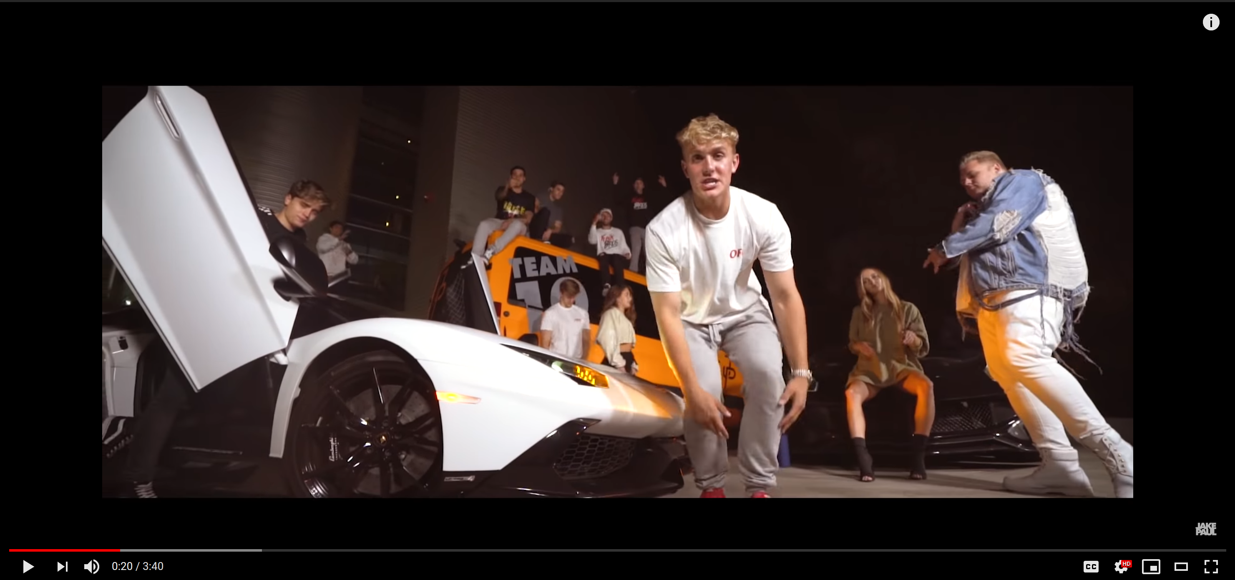
Now Playing
Magnolia
Playboi Carti
Guests
Notes:
DJ’s Page

Slide 3

Now Playing
Magnolia
Playboi Carti
Guests
Guest 1
Guest 2
Guest 3
Guest 4
Notes:
DJ’s Page

Slide 4
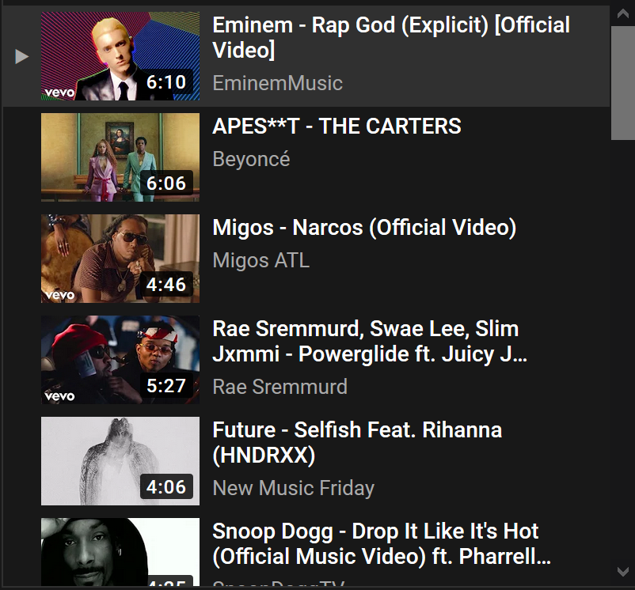
Search Music…
Now Playing
Magnolia
Playboi Carti
Guests
Notes:
DJ’s Page

Slide 5
Search Music…
Now Playing
Magnolia
Playboi Carti
Guests
Guest 1
Guest 2
Guest 3
Guest 4
Notes:
DJ’s Page

Slide 6

Now Playing
Magnolia
Playboi Carti
Guests
Notes:
Guest’s Page

Slide 7


Gucci gang
Gucci Gang (Lyrics)
Lil Pump
Add this song to queue?
Now Playing
Magnolia
Playboi Carti
Guests
Notes:
Guest’s Page

